Slide 1
Streaming the Future: Predicting Shows Renewals with Data
By: Fatiha Ashraf

Slide 2
Introduction
Research Question:
Can we predict TV show renewals using network, ratings, and viewership metrics?
Data Set:
Full TMDb TV Shows Dataset 2024 (150K Shows) by Asaniczka
Had 29 columns and over 150k rows
Notes:
I used a dataset of over 150,000 TV shows from TMDb. My goal was to see if we could predict renewals using network, vote average, and popularity.

Slide 3
Data Wrangling
Narrowed down to 10 columns
Name, number_of_seasons, vote_count, popularity, first_air_date, last_air_date, status
Created three columns
show_duration, renewed, network1

Slide 4
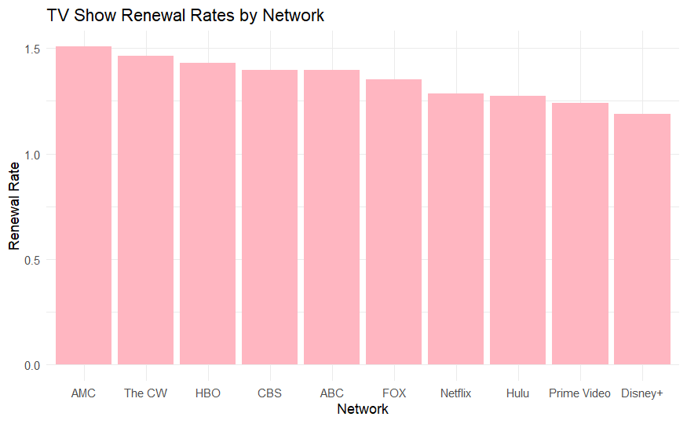
Visualization
AMC, The CW and HBO has highest renewal rates
Disney+, Prime Video, Hulu lowest renewal rates
Can assume that network are better than streaming services

Slide 5
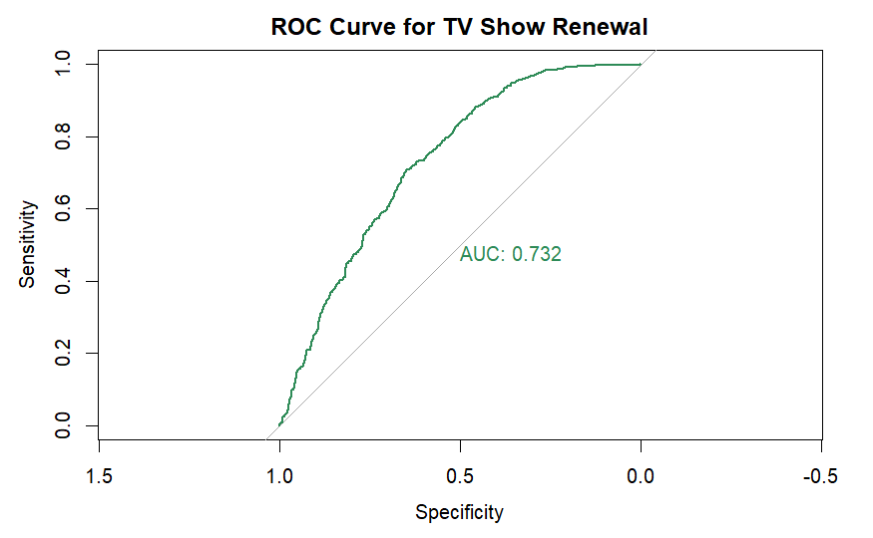
Modeling
Confirms networks, voting average, popularity predict renewals
73.2% chance correctly predict renewed show

Slide 6
Conclusion
Shows with higher ratings and popularity are more likely to be renewed
Network affiliation significantly affects renewal likelihood
Logistic regression model achieved AUC = 0.732
solid predictive performance
Limitations
Renewed may exclude mini-series or reboots
Missing variables
Future Analyzing
Using more show descriptions
Incorporating more features

Slide 7
Thank you!

